Slide 1



Josephine Mensah-Kane, Ishaack Mougamadou
Richard Burns, Fatma Altamimi

Slide 2
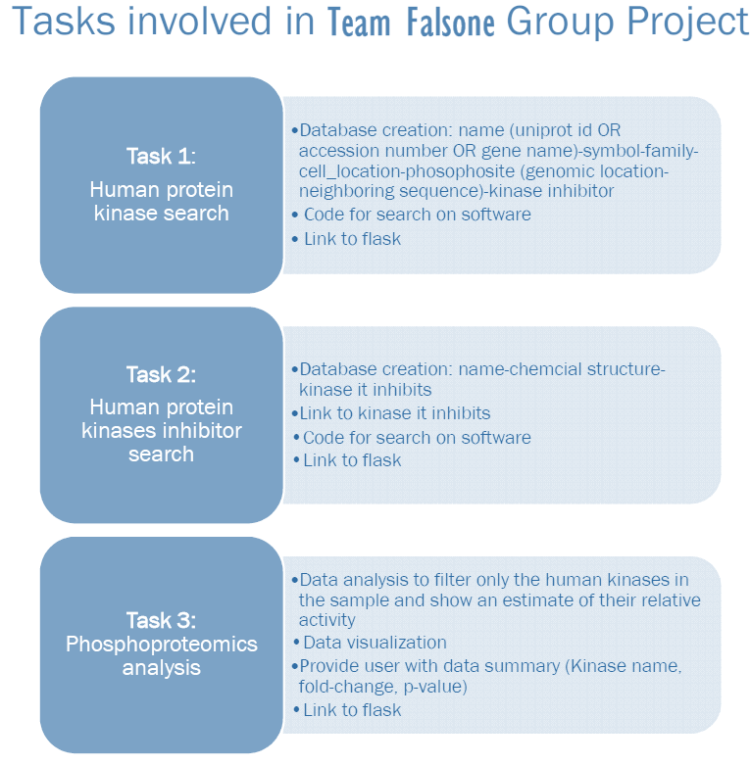

Slide 3
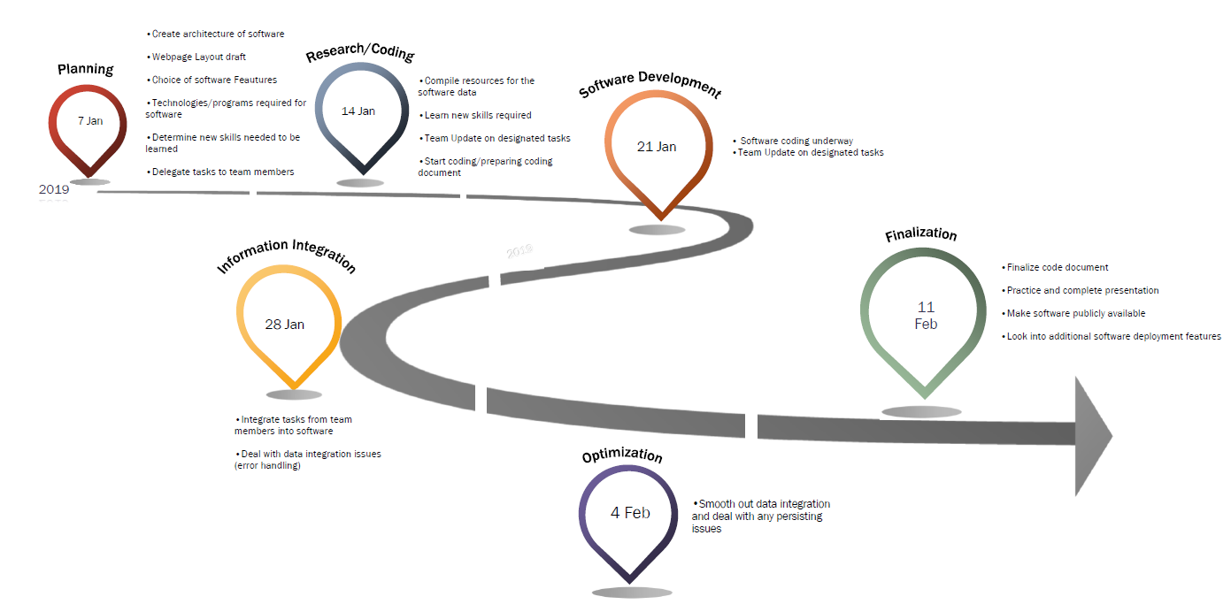
Project Timeline

Slide 4
Data acquisition
Human Kinases
  Universal Protein Resource (Uniprot.org, 2019).
Phosphosites
  PhosphoSitePlus (Phosphosite.org, 2019).
Kinase Inhibitors
  MRC Protein Phosphorylation Unit at the University of Dundee (Kinase-screen.mrc.ac.uk, 2019).
  Structures: Pubchem (Pubchem.ncbi.nlm.nih.gov, 2019).

Slide 5

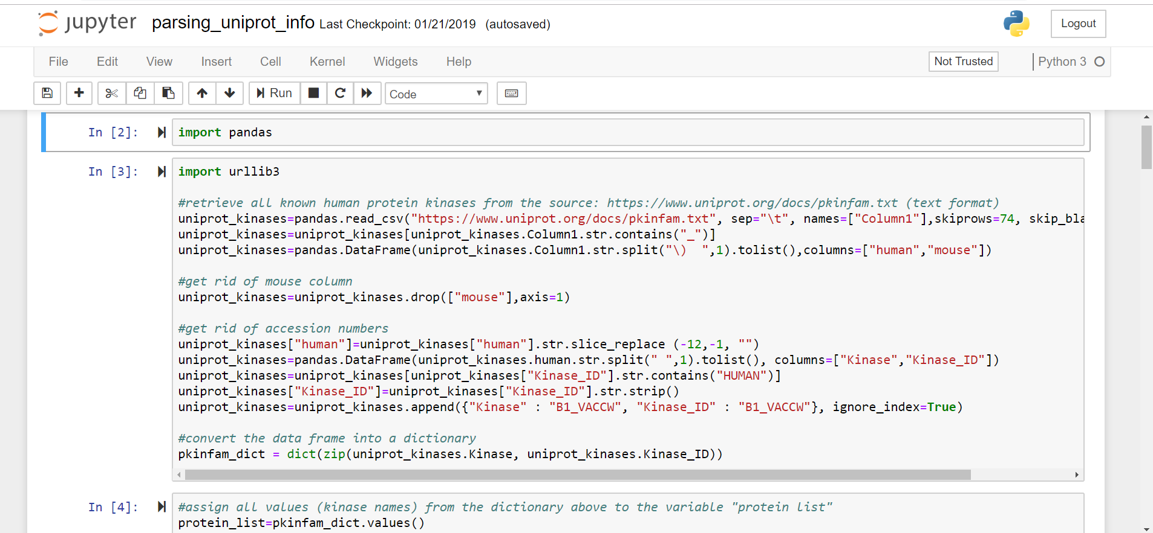
Retrieval of data resources, data clean-up, and data manipulation.

Slide 6
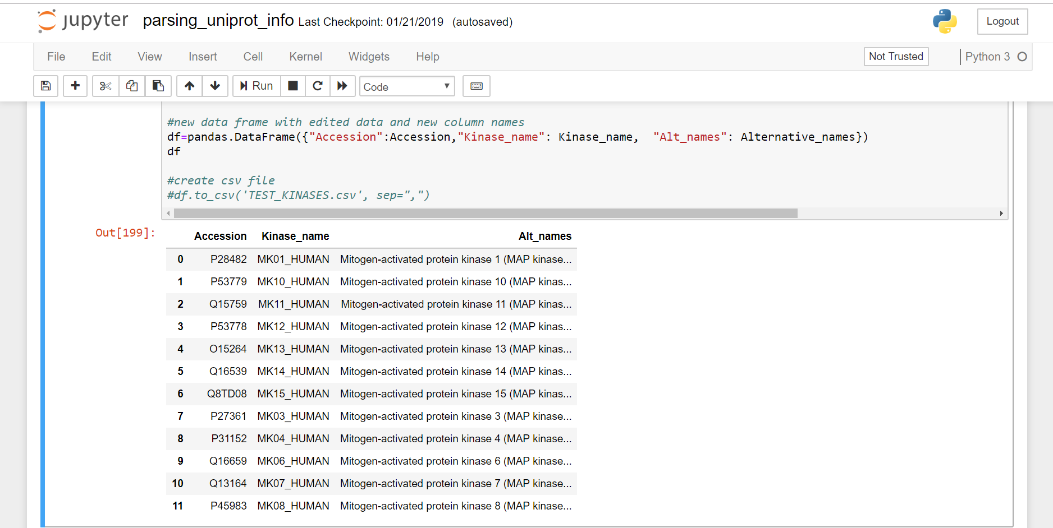
Retrieval of data resources, data clean-up, and data manipulation.

Slide 7
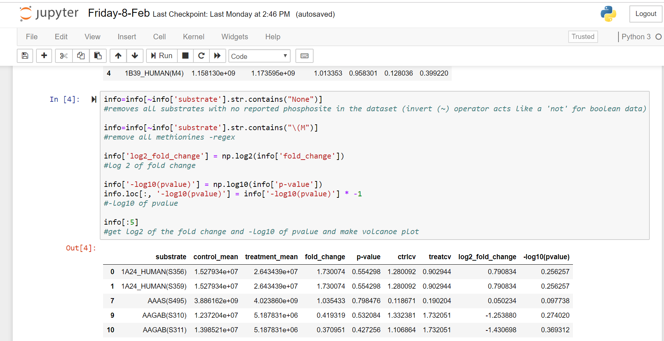
Development of the phosphoproteomics data processing and analyses.

Slide 8
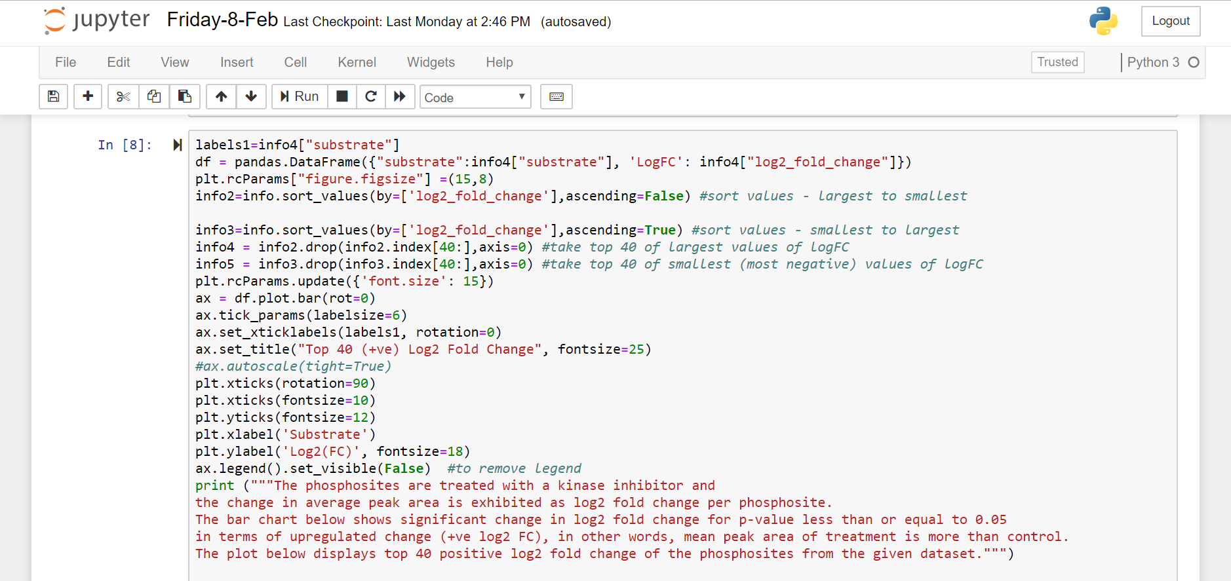

Slide 9
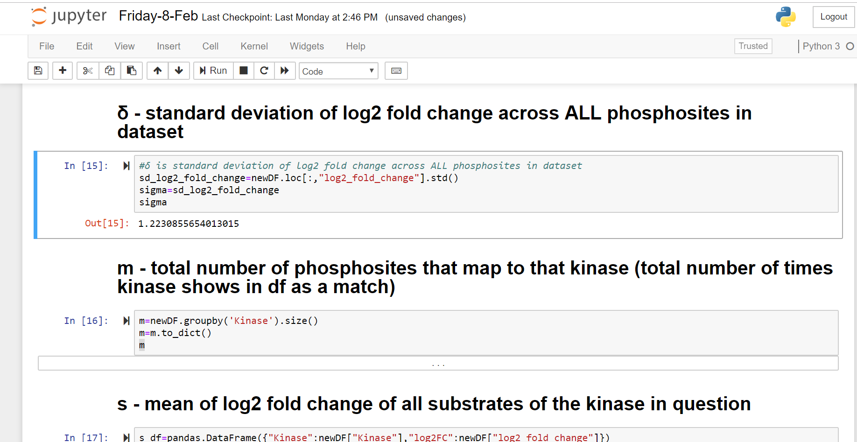
Notes:
Python scripts crucial for downstream implementation into Flask.

Slide 10
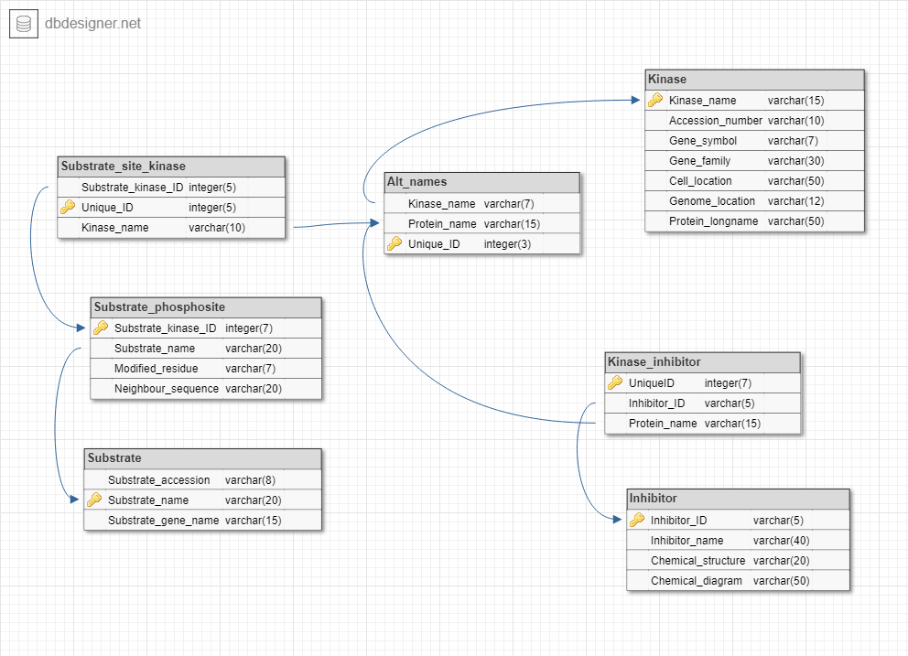
Building the Falsone Database

Slide 11
Kinase

Slide 12
Substrate

Slide 13
Inhibitor

Slide 14
Alternative names

Slide 15
Kinase-inhibitor relationship

Slide 16
Phosphosite-kinase relationship

Slide 17
Substrate-phosphosite

Slide 18

Object relational mapper from SQL to python
Incredibly intuitive and easy to use
Versatile and perfect for writing web page queries, with features such as the ‘like()’ query.
Likequery=session.query(kinase).filter(kinase.c.Kinase_name.like(user-search)).all()

Slide 19


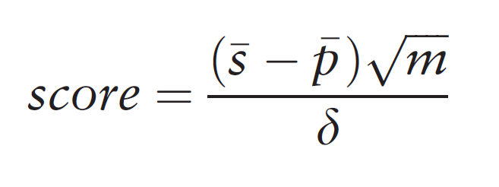

Phosphoproteomics Analysis
User-Uploaded Data
Kinase-substrate
relationship
(Falsone Database)
Statistical Analysis
Volcano Plot
Top 40 +ve log2 FC
Top 40 –ve log2 FC
Kinase-Substrate Enrichment Analysis (KSEA)*
Relative Kinase Activity Table
Top 40 Upregulated Relative
Kinase Activity
Top 40 Downregulated Relative
Kinase Activity

Slide 20
User-Uploaded Data
Upload Requirements (error handling)
Adaptable Code (headings)
Cleaning datasets

Slide 21
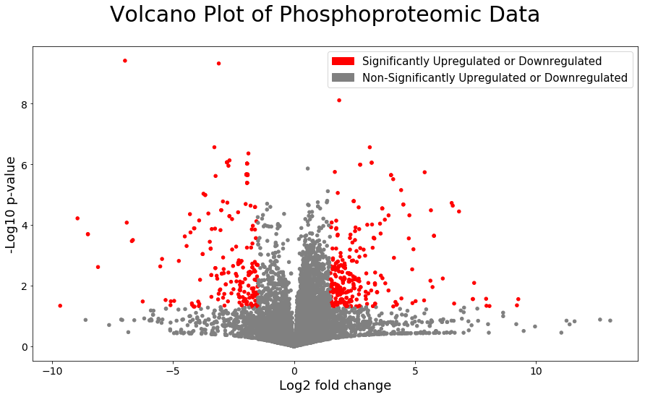
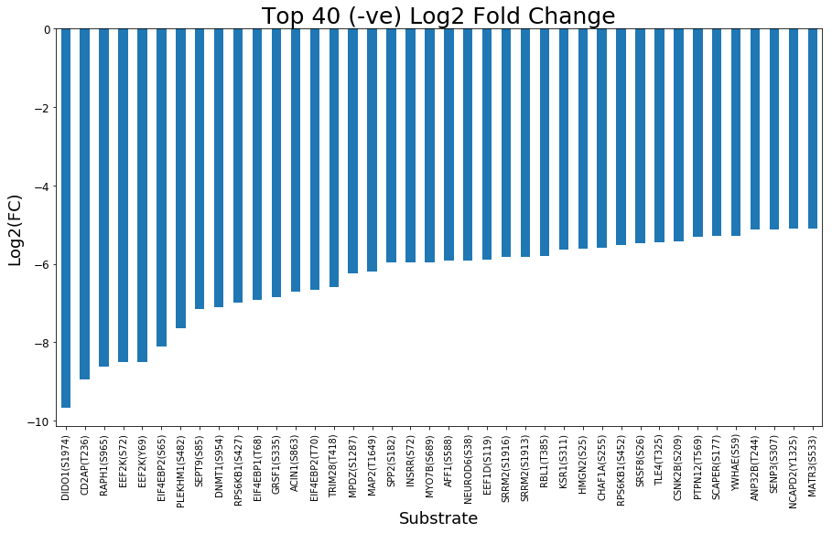
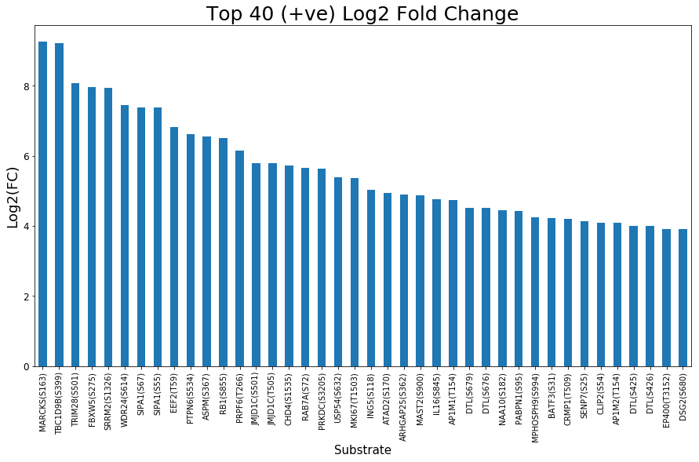
Data Visualization (pre kinase activity)
phosphorylated
dephosphorylated

Slide 22
Calling database
Substrate Gene/Protein name
PSP Limitations ( K-S relationships/ KSEA)
Kinase-substrate
relationship
(Falsone Database (PSP))

Slide 23
𝑠̅ - avg log2 fold change of known phosphosite substrates of that given kinase in the dataset
𝑝̅ - avg log2 fold change of all phosphosites in dataset
m - total number of substrates represented by the given kinase in the dataset
sigma – stdv of log2 fold change of all phosphosites in dataset
Kinase-Substrate Enrichment Analysis (Casado et al. 2013)

Slide 24
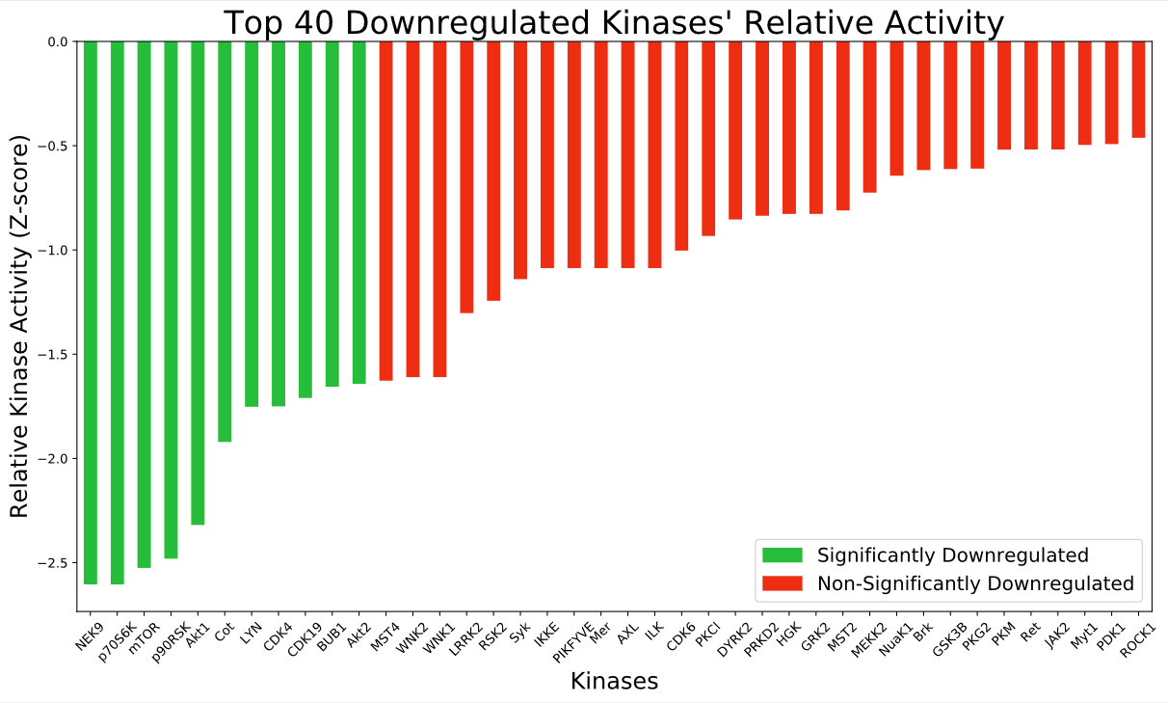
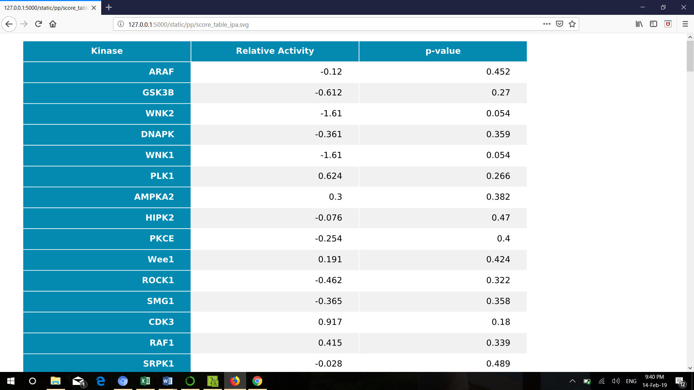
Phosphoproteomics
Analysis
Results
SciPy
(-) generally dephosphorylated substrates / (+) generally phosphorylated substrates

Slide 25


Flask-Bootstrap
index.css
index.html
(Child template)
base_index.html (Parent template)
index.min.css
JavaScript
scripts
Index.html
(Final Rendering by Jinja2 template engine)
Web Browser
Google Chrome
Mozilla Firefox
User-input

Slide 26




Software Architecture
Web Browser
Google Chrome
Mozilla Firefox
SQLite3 Database
Stored Locally
User-input
Web Application Server
Python 3.7 Microframework
Source Code
Flask- Uploads (Phosphoproteomics)
Flask- Bootstrap (Template Style and Jinja2 Template Engine)
Flask-SQLAlchemy (Connecting the database)
HTTP Templates
JavaScript
Libraries
e.g. JQuery Data Tables
Static
Images
CSS

Slide 27
Website Navigation Layout
Search toolbar
Kinase Search
Phosphosite browser
Inhibitor Search page
Inhibitor search
Homepage
Upload data
Phosphoproteomics analysis results
About us

Slide 28
Website deployed online
http://falsone-kinase-browser.eu-west-2.elasticbeanstalk.com

